Slide 1
Big League Barbers App
Prem
Connor
Myles
Grace
Suli
Notes:
Prem

Slide 2
Agenda
01
Problem Statement
02
Software Requirements
03
Website Production Team
04
Use Cases, User Stories, Website Architecture
05
Technologies
06
Risks and Contingencies
Notes:
Prem

Slide 3
Problem Statement
Big League Barbers currently uses an outdated scheduling system that limits efficiency and customer convenience. Customers struggle to book appointments easily, track loyalty rewards, and receive reminders. Staff must manually manage bookings and cancellations, leading to errors and reduced productivity.
Our project aims to solve these issues by developing a modern web-based appointment and rewards application that streamlines scheduling, automates notifications, and enhances the overall customer experience.
Notes:
Prem

Slide 4
Software Requirements
Both Mobile and web-based UI for scheduling appointment
Database to store user’s name, email, phone number, password, and discounts
When a user makes an appointment, it will show up on Big League Barbers side
Integration with guestVision API
Notes:
Grace

Slide 5
Requirements
Functional
Nonfunctional
Schedule haircuts by themselves or with a beard trim
Create accounts
Promote special offers and coupons through notifications
7th inning stretch system
After 7th haircut, the next one is $2 off
Users receive notification after 7th haircut
Send reminders for appointments containing barber, type of service, and time of appointment
Automatically schedule with the next stylist available if not scheduling with a specific stylist
Convenience/Usability
Application should be easy to navigate
Appointments should be essay to manage
Scheduling needs to be convenient and easy
Users should be able to opt in/out of notifications easily
Security
User information
Stored securely
Readable by those that require
Editable by user
Non authorized cannot access
Promos only accessible to staff and users
Duplicate codes shouldn’t occur
Application can handle multiple users without performance issues
Notes:
Grace

Slide 6
Discussions with
Website Production
Team
IT team is a one semester project
Sponsor wants the app to mimic the website
Both need to be able to access the database
Able to grab everything off of the guestVision API
Notes:
Grace

Slide 7
Use Cases
User
Log in / Sign Up
Manage / Schedule Appointments
Specific Stylist or any currently available
Cancellation/Rescheduling
Use Rewards/Referral Codes
Edit Account Info
Name, Email. Phone #, Password
Tailor notifications (Push, Email, Text)
Staff
Verify Discount Codes
Change available discounts
Stylist Summary
Shows when specific stylists were scheduled
Notes:
Connor

Slide 8
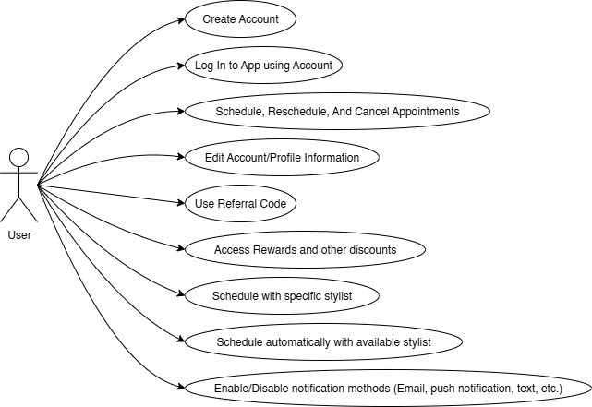
User Diagram

Slide 9
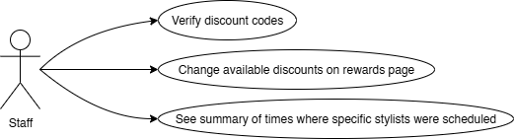
Staff Diagram

Slide 10
User Stories
As a user, I want to quickly open the application and schedule an appointment, regardless of having an account or not.
As a user, I want to create an account on the application for user-specific features.
As a user, I want to quickly and conveniently cancel an appointment if I need to re-schedule.
As a user, I want to either schedule with a specific stylist, or just be automatically scheduled to whoever is available at a given time.
As a user, I want to be able to edit my profile information, such as my email, phone number, password, etc.
As a user, I would like to get the contact information of the people working at Big League Barbers.
As a user, I would like to access available rewards and discounts for haircut appointments.
As a staff member, I want to verify both referral codes and other discount codes from the app.
As a staff member, I want cancelled appointments to be automatically cleared from the schedule
As a staff member, I want to be able to change which promotions appear on the application at specific times.
Notes:
Connor

Slide 11
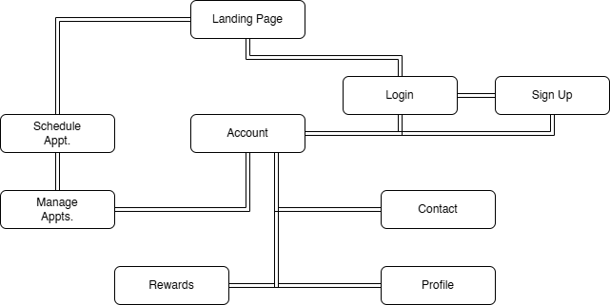
Website Architecture
Notes:
Connor

Slide 12
Technologies
Front-End
React → React Native
Back-End
Node.js
Express.js
Database
SQL Server
Node-MSSQL Module
API
GuestVision (Proprietary)
Additional technology to be added or changed as project requires.
Notes:
Suli

Slide 13




System Model
React Native
Node.js & Express.js
SQL Server / GuestVision API
User Interface
Interact with customers
Backend Logic
Communicates with database & API
Database
Stores important information
Notes:
Suli

Slide 14
Project Development Plan
Week 1
Week 4
Week 8
Week 10
Week 12
Week 14
Week 15
- Understand the project
- Develop a plan
- Meet with team and sponsor
- Develop Basic Prototype
- Meet with IT team
- Understand future goals and possible changes
- Finalize Midterm Report
- Complete Learning
- Complete Development Plan
WE’RE HERE
Planning & Setup
Prototyping & Planning
Polish Prototype & Begin Learning
Complete Learning & Plan Development
- Polish Prototype
- Learn React / Node / SQL if needed
- Understand IT team’s goals
- Finalize Plan
Notes:
Suli

Slide 15
Risks and Contingencies
Risk 1: Develop Core Booking System
Impacts: A malfunctioning or unreliable booking feature would directly affect customer satisfaction and the overall credibility of the platform.
Contingency plan: Temporarily revert to a manual booking confirmation system using admin approval until the automated process stabilizes.
Risk 2: Server and Database Integration
Impacts: A failed connection or poor data retrieval would halt core app features like appointments and user accounts.
Contingency plan: Maintain local data caching for critical operations and create a backup server mirror.
Risk 3: User Authentication and Security
Impacts: A breach would compromise customer trust and could expose personal data, leading to reputational and financial damage.
Contingency plan: In case of a breach, disable all logins, notify users immediately, and force password resets.
Notes:
Myles

Slide 16
Prototype Demonstration
Capstone Project – Figma
Notes:
Myles

Slide 17
Thank you!
Any Questions?
Notes:
Myles

